Slide 1
Data Science
Machine Learning Based Analysis
of Gene Expression and Lipid Composition
of the Schizophrenia Brain
Student: Mikhail Zybin
Research Advisor: Philipp Khaitovich
June, 2023
1

Slide 2
General problem / Introduction / Background
positive symptoms | negative symptoms | cognitive symptoms
delusions and hallucinations | loss of typical affective functions | deﬁcits in attention and executive functioning
2
Notes:
Phrases you may find useful:
The area of my research covers …
Today … has been already studied in the field.

Slide 3
General problem / Introduction / Background
Genes: structural and functional units of DNA.
Gene expression – process of reading the information from the gene and building a corresponding protein.
Lipid is any of a diverse group of organic compounds including fats, oils, hormones, and certain components of membranes that are grouped together because they do not interact appreciably with water.
3
Notes:
Phrases you may find useful:
The area of my research covers …
Today … has been already studied in the field.

Slide 4
Aim and objectives
The goal of this research is to find out what genes, what lipids in what brain regions are most relevant to schizophrenia.
- identify the most relevant regions, genes and lipids from the available data
- potential future experiments on molecular mechanisms of SZ would be able to rely only on a small subset of regions, genes and lipids
- we wanted to see whether certain genes or lipids contain most of the necessary signal that distinguishes healthy brains from SZ brains
4
Notes:
The overall purpose of the work is to …
The objectives of the present research run as follows:
1…
2…
3…

Slide 5
Dataset Description
Lipids and gene expressions from Vladimir Zelman Center for Neurobiology and Brain Rehabilitation, Skoltech
- 4 individuals with paranoid schizophrenia and 4 individuals without this diagnosis, postmortem
- bulk RNA-seq for 14179 genes, 35 different regions
- high performance liquid chromatography coupled with mass spectrometry for 347 lipids, 50 different regions
5

Slide 6
Dataset Description
Another lipid dataset from Vladimir Zelman Center for Neurobiology and Brain Rehabilitation, Skoltech
- 12 individuals with paranoid schizophrenia and 12 individuals without this diagnosis, postmortem
- high performance liquid chromatography coupled with mass spectrometry for 445 lipids, 4 different regions
6

Slide 7

Dataset Description
External RNA-seq dataset
- anterior cingulate cortex
- dorsolateral prefrontal cortex
- nucleus accumbens
3 groups of 24 patients
schizophrenia, bipolar disorder, or major depressive disorder, and from 24 control subjects
7

Slide 8
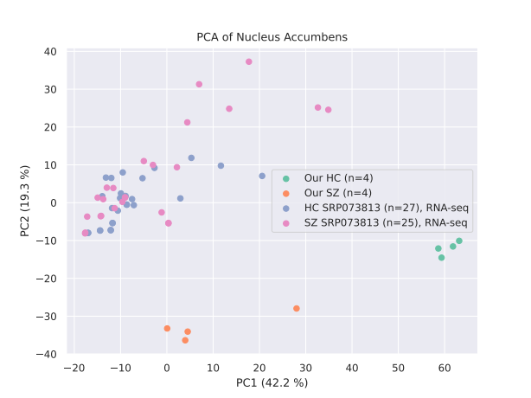
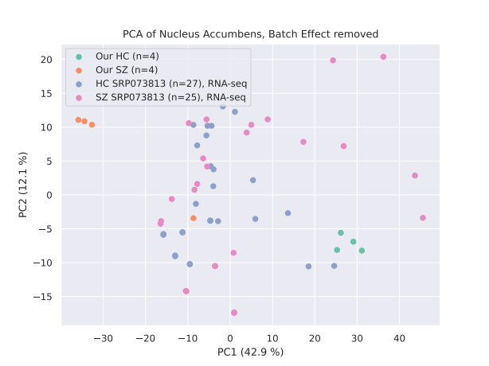
Methods
Batch-effect removal for making external datasets comparable
PCA of Nucleus Accumbens
PCA of Nucleus Accumbens, BE removed
8

Slide 9
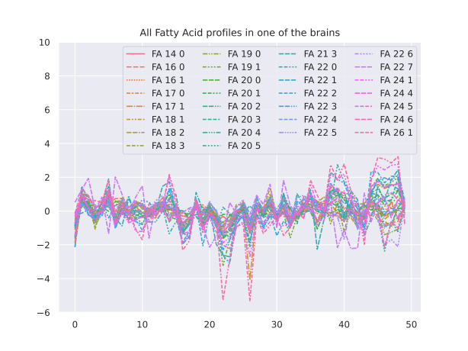
Methods
Data Normalization
for each brain we make the sum of all observations for each gene and lipid equal to zero
9

Slide 10
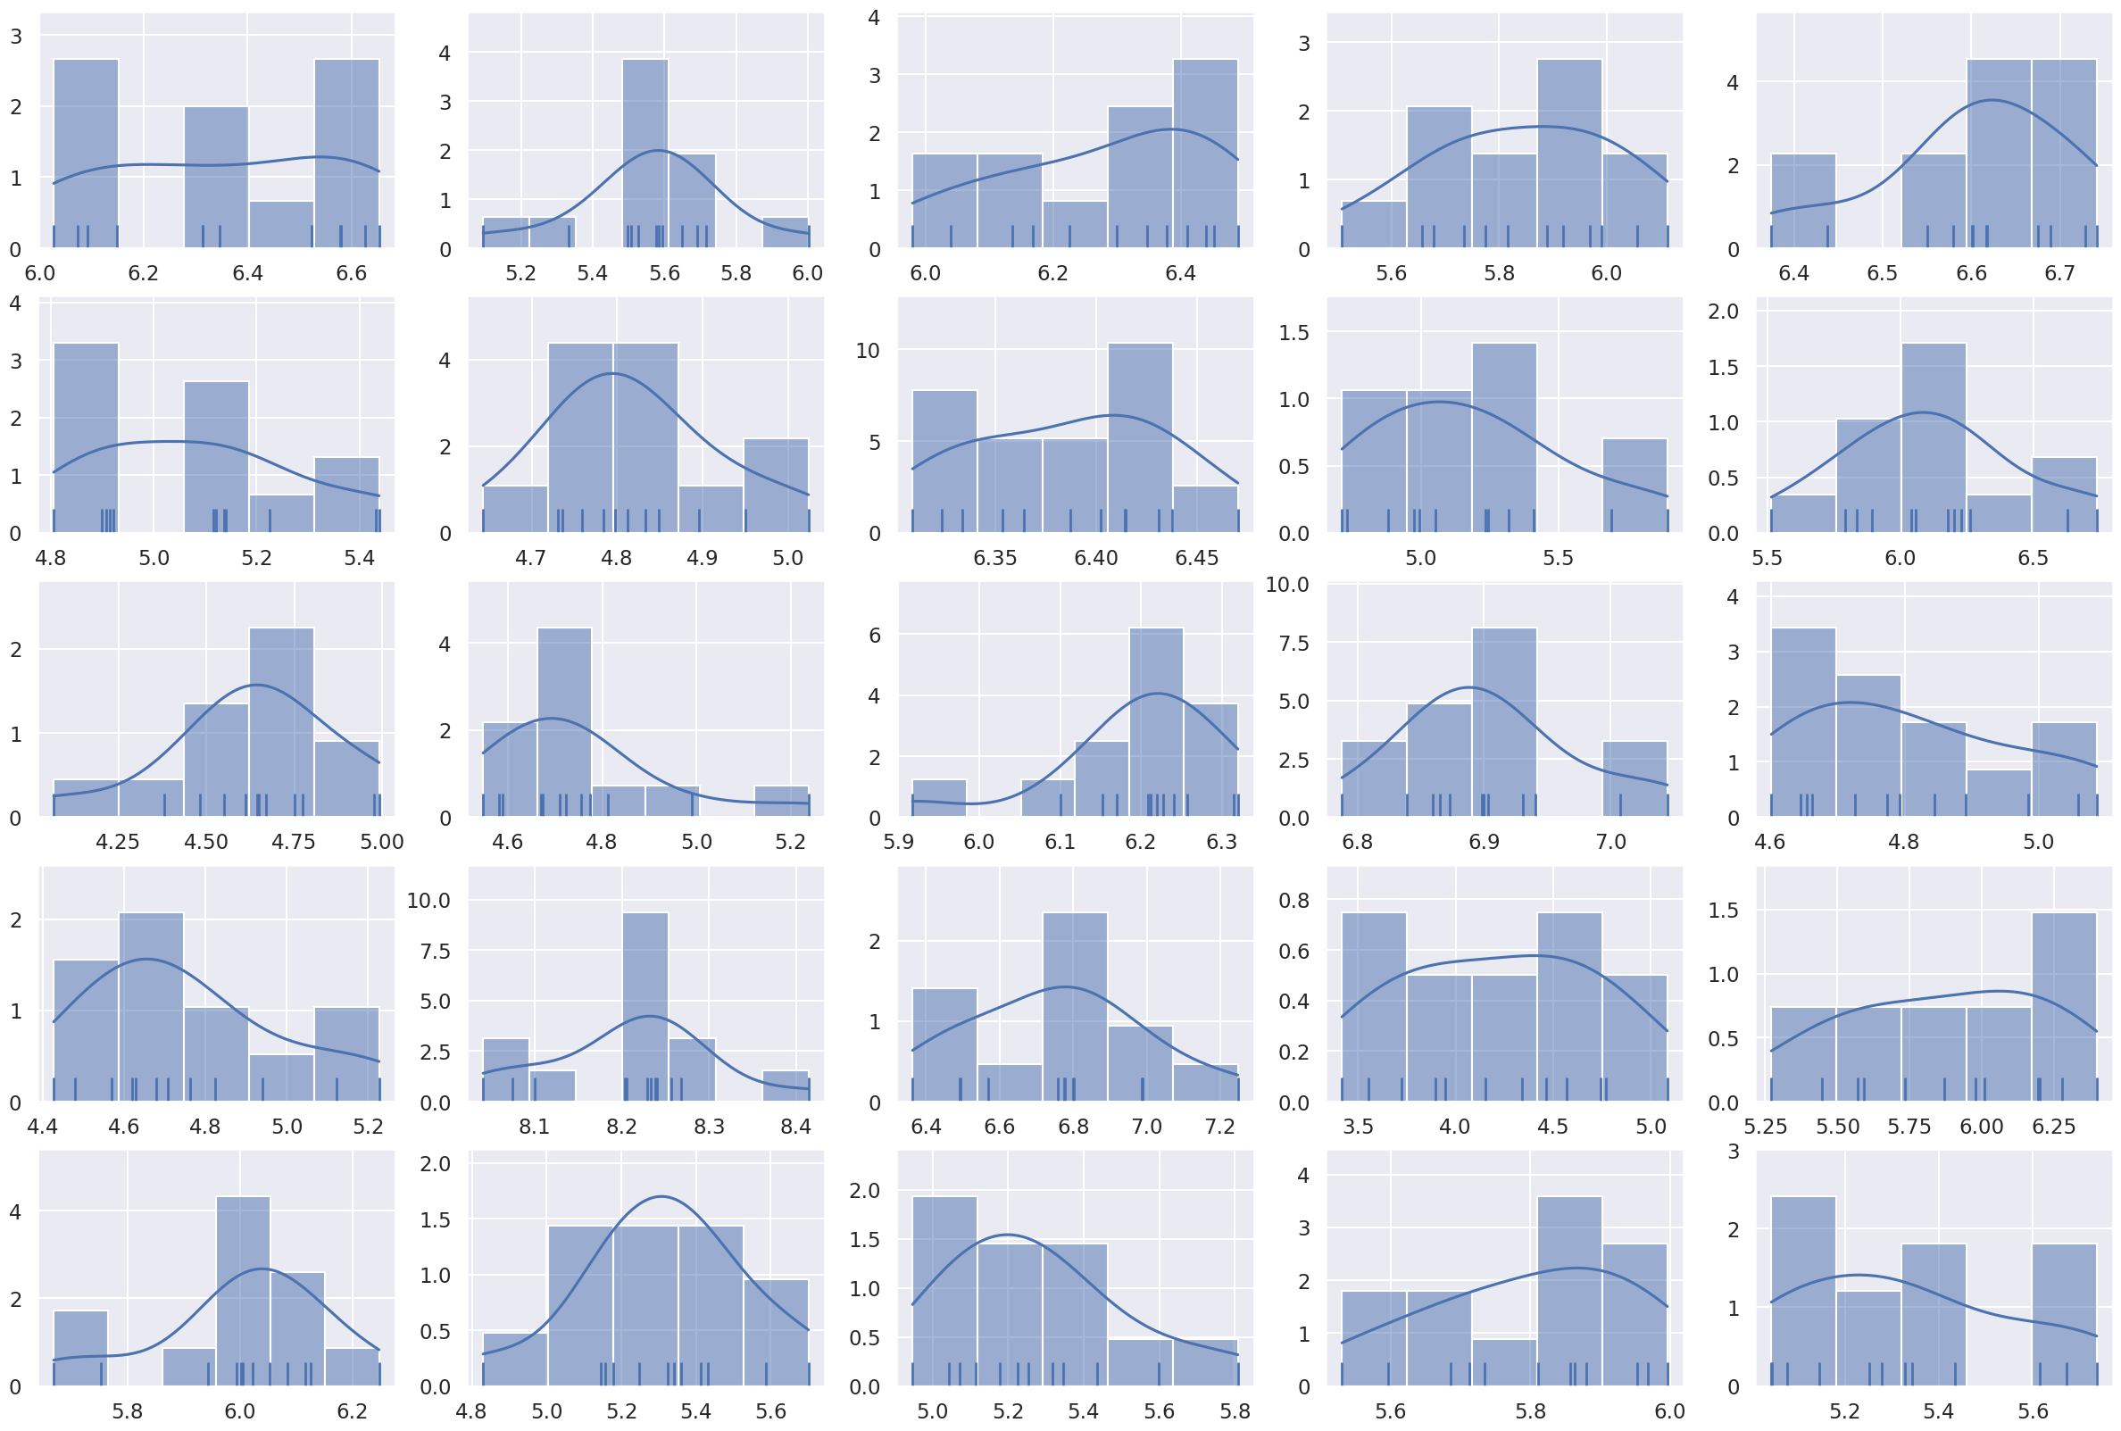
Methods
Data Augmentation
Estimate distributions
Assume independence
Generate data from the estimations
Or add external dataset
Example lipids distributions
10

Slide 11
Methods
Training Dataset Preparation
Brain as object (“Is the brain schizophrenic?”)
we do not know exactly which parts of the brain are mostly affected by the illness, and so we need all of the available information about the brain for the classification
the connection between the same molecules in different regions is lost - they become different columns in the training table
11

Slide 12
Methods
Training Dataset Preparation
Region as object (“Does a region belong to schizophrenic brain?”)
here we have fewer features, and the connection between the measurements of the same molecule in different regions is not lost (they become one column in the table)
we lose information about the location of the region, and that some regions come from the same brain
12

Slide 13
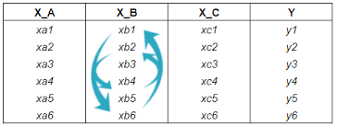
Methods
Importance Estimation
Random Forest
the impurity-based feature importances. The importance of a feature is computed as the (normalized) total reduction of the criterion brought by that feature. It is also known as the Gini importance.
Permutation
Prediction accuracy (region as object)
Sum of the importances of the corresponding features (brain as object)
13

Slide 14
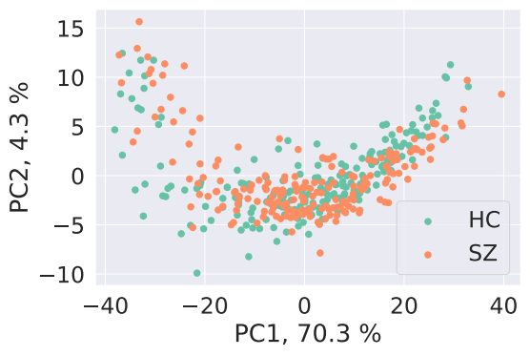
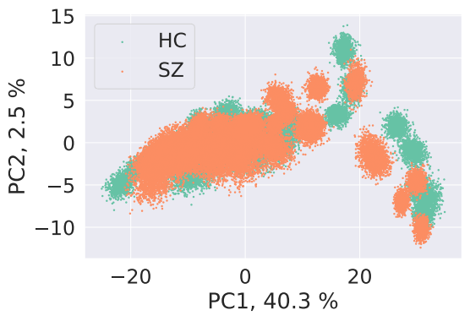
Discussion of the results
Data has been augmented
- Transcriptomics – by external dataset, and synthetic generation
- Lipidomics: by synthetic generation
Region as object, real lipidomics data
Region as object, synthetic lipidomics data
14

Slide 15
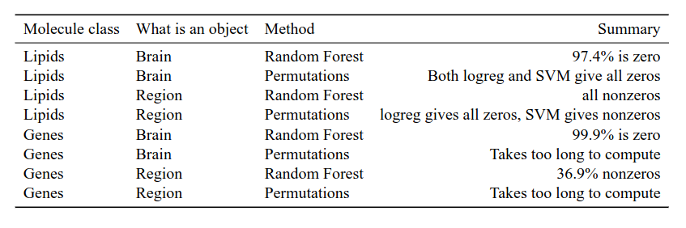
Discussion of the results
15

Slide 16
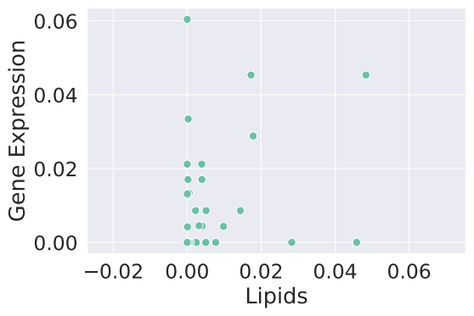
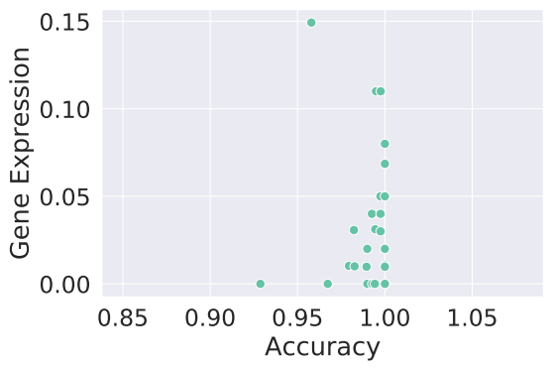
Discussion of the results
Stability analysis
Comparison of importances of the regions
PearsonR = 0.17
Comparison of importances of regions
PearsonR=-0.02
16

Slide 17
Conclusions
Small dataset
Data augmentation (synthetic dataset generation + external dataset)
Classification
Importance estimation
Stability analysis
17
Notes:
Phrases you may find useful:
All these results suggest that …
We can conclude that …
Taken together, these results point to three conclusions …
To sum up, …
Although it is still too early to draw a definite conclusion, it can be stated that …
Although the obtained data are limited, we may conclude that

Slide 18
Additional Slides
Notes:
Phrases you may find useful:
I would like to express my gratitude to … who <provided smth /assisted in smth/ conducted smth/ etc.>
Thank you for your attention. Now I’m ready to answer your

Slide 19
Acknowledgements
Maria Osetrova, research engineer at Skoltech Center of Life Sciences
Provided the dataset and explanation of its file structure
Skoltech for giving the opportunity to do computations on Arcuda supercomputer
Notes:
Phrases you may find useful:
I would like to express my gratitude to … who <provided smth /assisted in smth/ conducted smth/ etc.>
Thank you for your attention. Now I’m ready to answer your

Slide 20
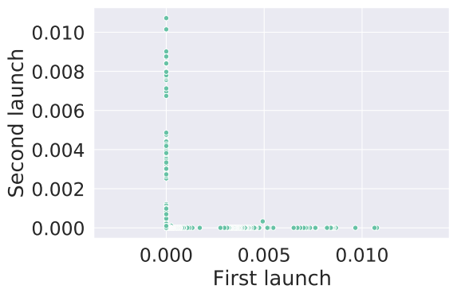
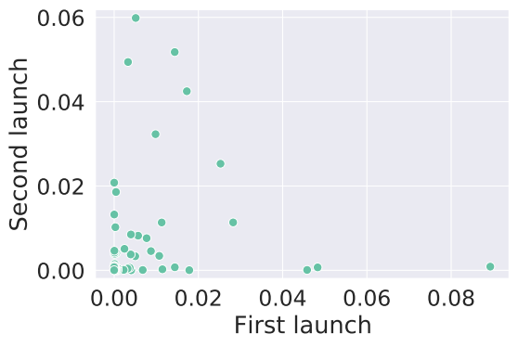
Discussion of the results
Stability analysis
Lipidomics data, brain treated as object, importances of molecules in regions
Lipidomics data, brain treated as object, importances of regions

Slide 21
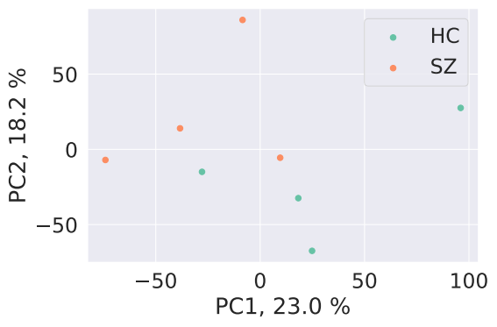
Methods
Training Dataset Preparation
Real lipidomics dataset, brain as object
Real lipidomics dataset, region as object
11

Slide 22
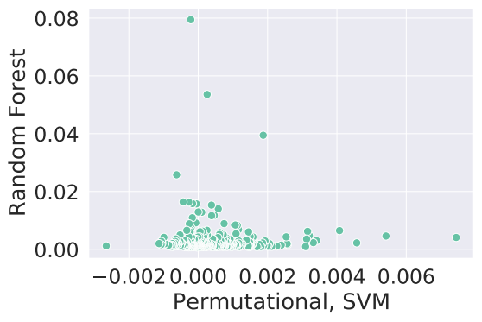
Additional Slides
Comparison of importances of lipids based on RF and on SVM
Notes:
Phrases you may find useful:
I would like to express my gratitude to … who <provided smth /assisted in smth/ conducted smth/ etc.>
Thank you for your attention. Now I’m ready to answer your

Slide 23
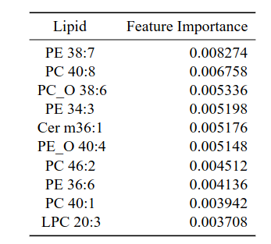
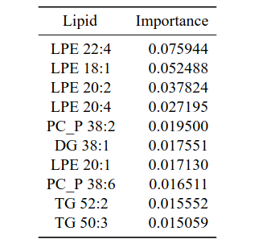
Additional Slides
Notes:
Phrases you may find useful:
I would like to express my gratitude to … who <provided smth /assisted in smth/ conducted smth/ etc.>
Thank you for your attention. Now I’m ready to answer your

Slide 24
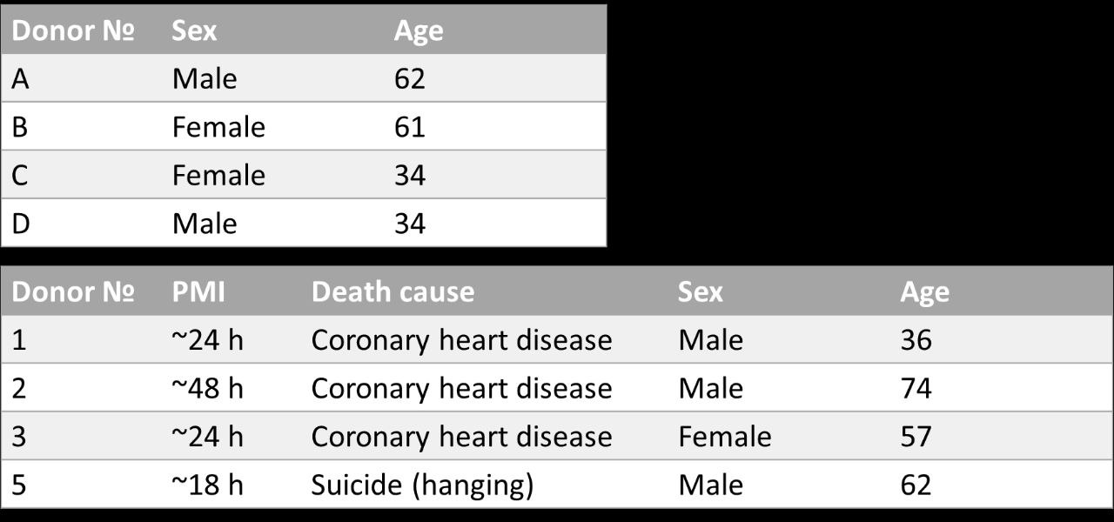
Additional Slides
Notes:
Phrases you may find useful:
I would like to express my gratitude to … who <provided smth /assisted in smth/ conducted smth/ etc.>
Thank you for your attention. Now I’m ready to answer your

Slide 25
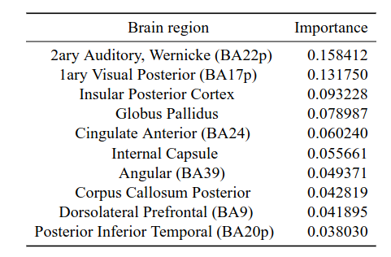
Additional Slides
Random Forest importances of each region, brain as object
Notes:
Phrases you may find useful:
I would like to express my gratitude to … who <provided smth /assisted in smth/ conducted smth/ etc.>
Thank you for your attention. Now I’m ready to answer your

Slide 26
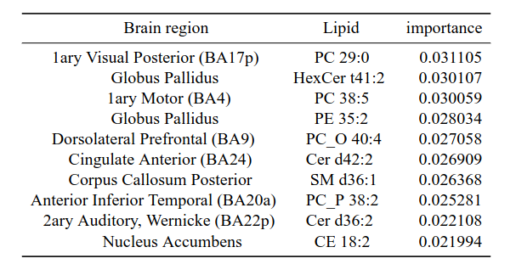
Additional Slides
Random Forest importances of each lipid in each region, brain as object
Notes:
Phrases you may find useful:
I would like to express my gratitude to … who <provided smth /assisted in smth/ conducted smth/ etc.>
Thank you for your attention. Now I’m ready to answer your

Slide 27
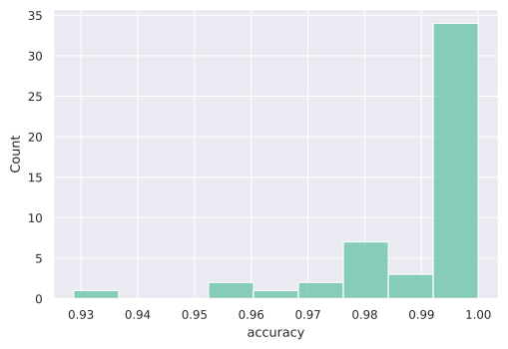
Additional Slides
Distribution of the prediction accuracy for the regions
Notes:
Phrases you may find useful:
I would like to express my gratitude to … who <provided smth /assisted in smth/ conducted smth/ etc.>
Thank you for your attention. Now I’m ready to answer your

Slide 28
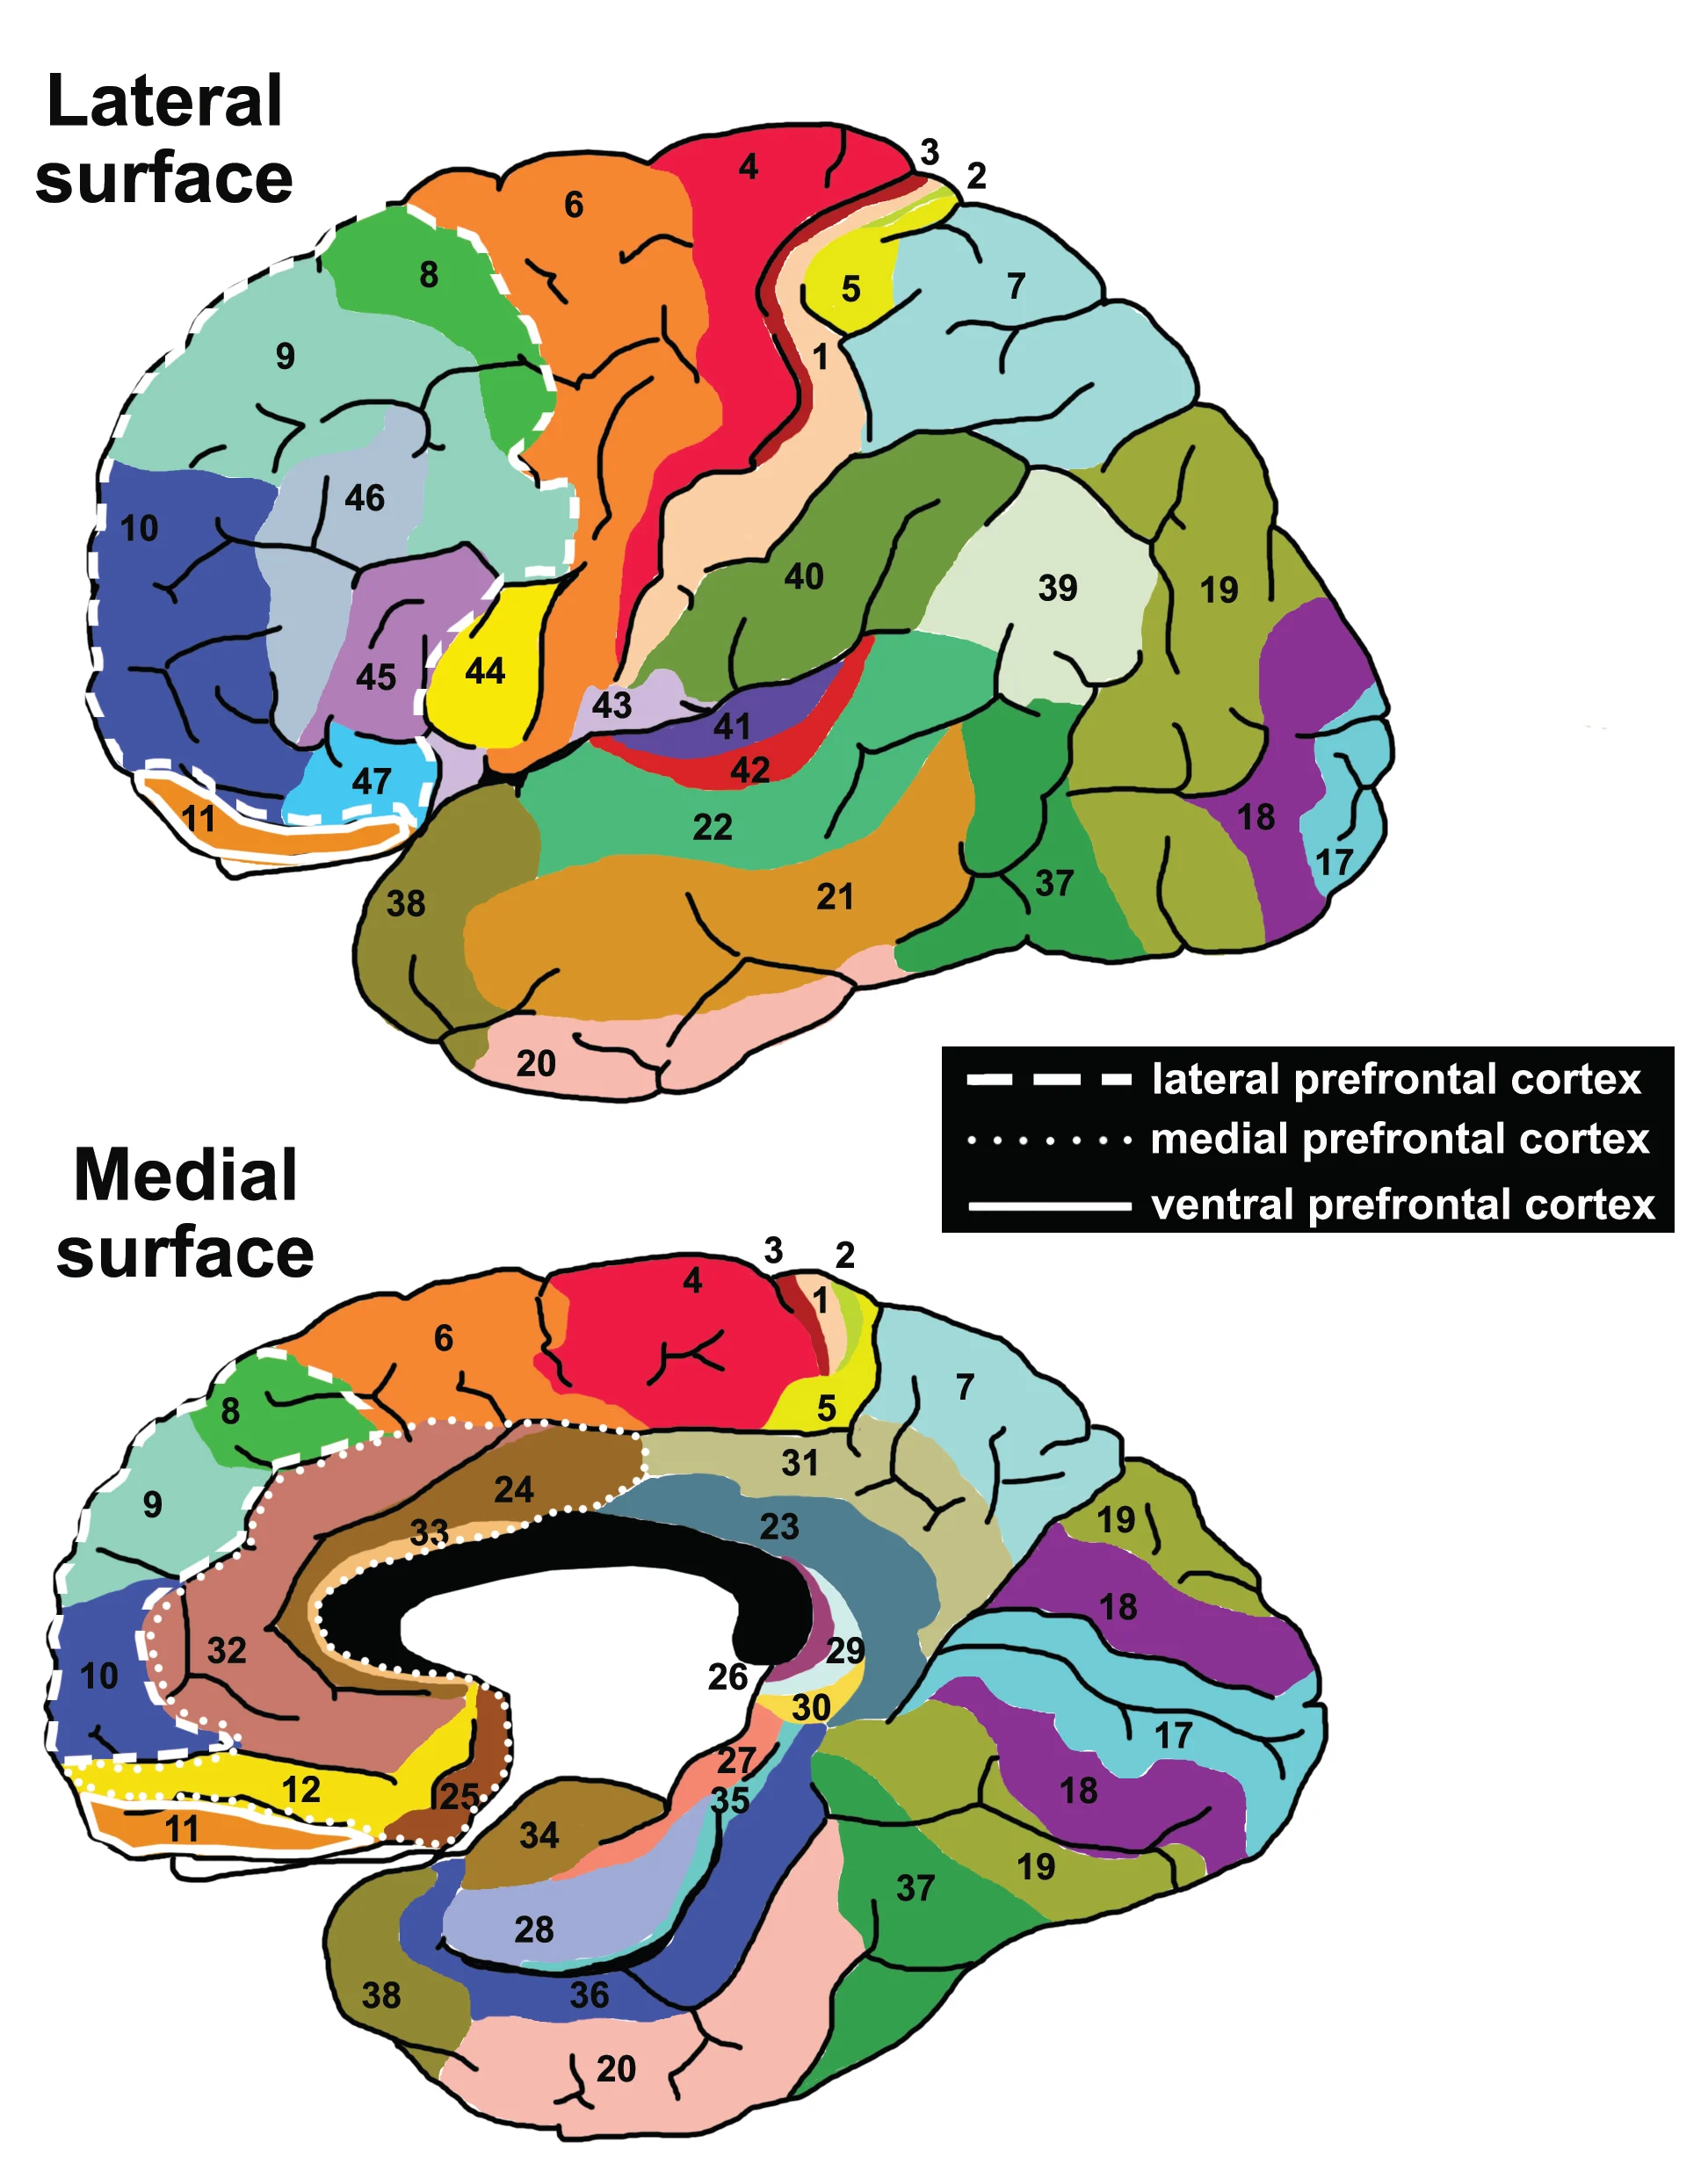
General problem / Introduction / Background
A Brodmann area is a region of the cerebral cortex, in the human or other primate brain, defined by its cytoarchitecture, or histological structure and organization of cells
Notes:
Phrases you may find useful:
The area of my research covers …
Today … has been already studied in the field.

